Slide 1
Engineering Cycle Worksheet
Jad Isidore
2021101043

Slide 2
1 DECOMPOSE the problem
What is the problem you are solving? What smaller problems can you break it into?
Big Goal:
To print a particular pattern 4 times.
Subgoals:
Enter my full name first.
Use four asterisks in the second line.

Slide 3
1 DECOMPOSE the problem
Based on your understanding of the problem, make an educated guess about which coding concepts you will use.
Coding concepts:
There is a possibility of me having to use variables and for loops.

Slide 4
2 PLAN a solution
How should your algorithm solve the problem? Plan your solution in plain English or pseudocode.
First, I have to…
Establish all my variables.
Then I have to…
Ensure that no reserved word or like variables were used
Continued…
Enter for loop statement.

Slide 5
2 PLAN a solution
How should your algorithm solve the problem? Plan your solution in plain English or pseudocode.
Continued…
Ensure that the looping statement is set for the correct number of times.
Finally, I have to…
Implement the solution.

Slide 6
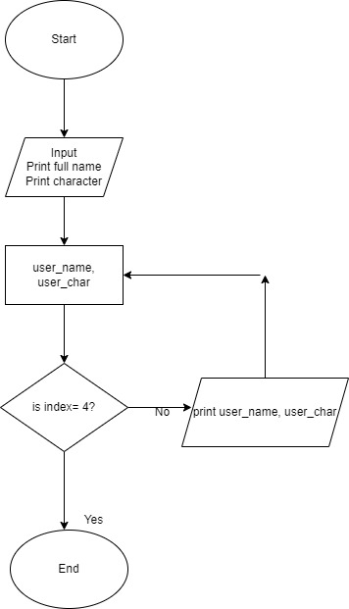
2 PLAN a solution
Flowchart.

Slide 7
2 PLAN a solution
IPO Chart
INPUT | PROCESS | OUTPUT
user_name | user_name | Display Pattern
user_char | user_char
for loop | Print user_name, user_char Pattern

Slide 8
3 IMPLEMENT the solution
Translate your solution into real code. Using your knowledge of Python syntax. Write it here first.
user_name = “Jad Isidore”
user_char = “****”
for i in range (4):
print(user_name)
print(user_char)

Slide 9
4 TEST and DEBUG the code
Type your code into the code editor. Hit “run” to see if your code does what you intended. Make sure to check your spelling, syntax and structure. Type ‘x’ for which happens, add additional where applies.
x | Code works as intended
x | Everything is spelled correctly
x | Lines are properly indented
x | Parentheses () are correct
 | Capitalization is correct
x | Variables are defined before I use them

Slide 10
If you got no errors. Screenshot your code and the output and paste them onto this slide. If you got errors, please advance to the next slide

Slide 11
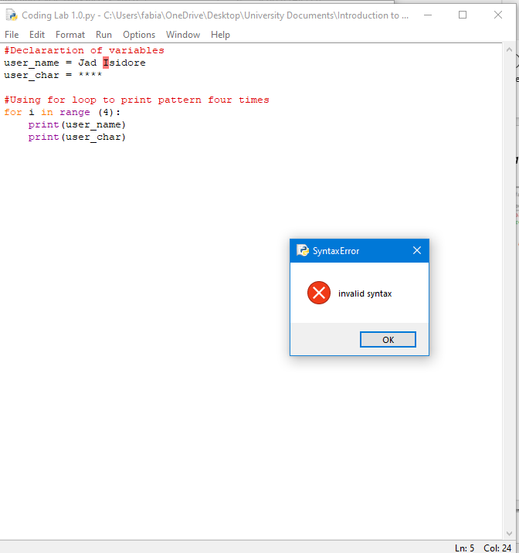
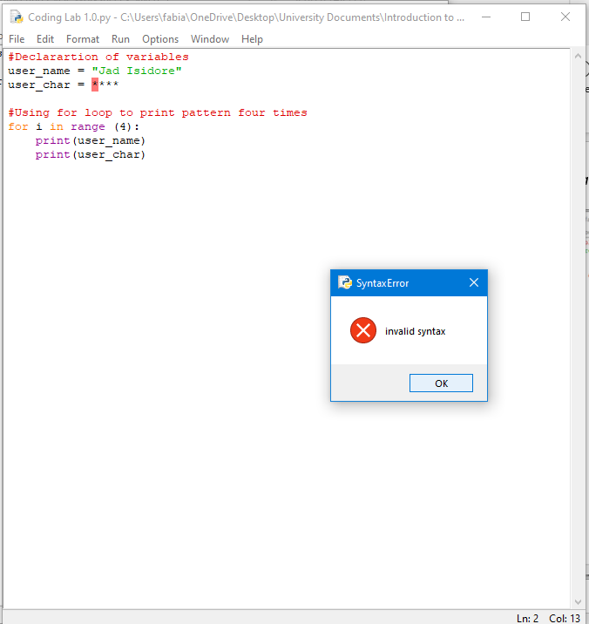
If you got errors. Screenshot your code and the error you got and paste them onto this slide.

Slide 12
What caused the error?
Did not place inverted commas before and after values.

Slide 13
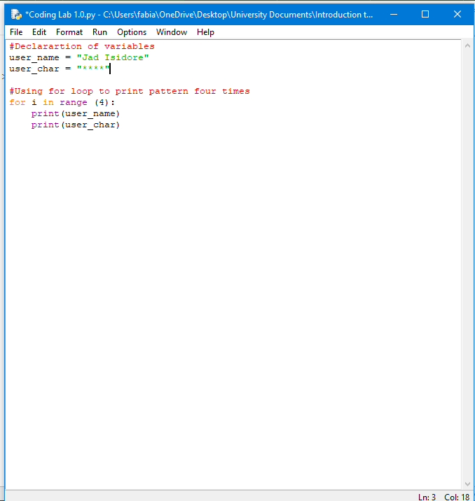
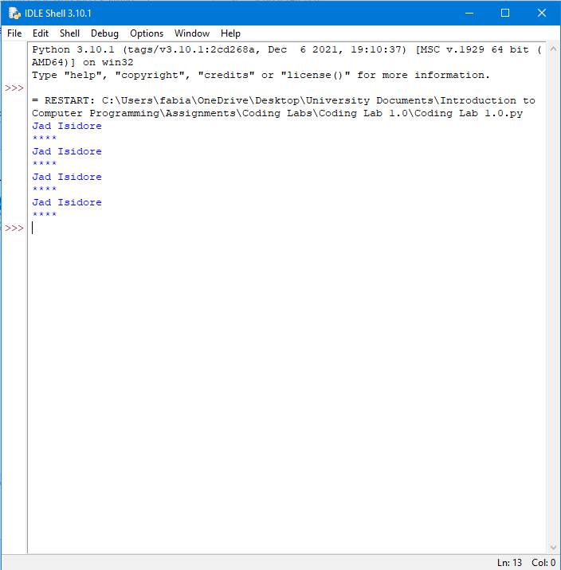
Screenshot the newly adjusted code and its output.

